Slide 1
FADING IN THE MOBILE ENVIRONMENT

Slide 2
Fading
There are substantial amplitude and phase fluctuations and the signal is subjected to fading.
When it is observed that for a distance of couple of km, the power of the signal fluctuates around a mean value and the fluctuation have a longer period which is referred as long-term or slow-fading.
If the signal power over a few hundred meters is found to be fluctuates more rapidly which are caused due to multipath, this phenomenon is referred as fast-fading or short-term fading.
A steady decrease in the received signal power at a separation distance ‘d’ of several kms is said to be attenuation.

Slide 3
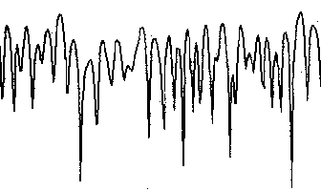
Fading
Fast Fading (Short-term fading)
Slow Fading (Long-term fading)
Signal Strength
(dB)
Path Loss
Distance

Slide 4
Shadowing
Because of shadowing by buildings and other objects, the avg within small areas also varies from one small area to the next in an apparently random manner, referred to as the shadow effect.
Shadow effect is often called log-normal fading.

Slide 5
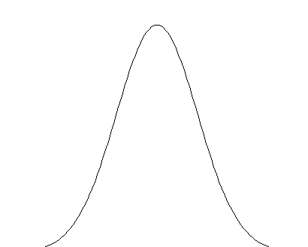
Log-normal Distribution
2σ
p(M)
M
M
The pdf of the received signal level

Slide 6
Contd…
Received power P_{r}(d), at a distance d > d₀ from a transmitter, is related to P_{r} at d₀, which is expressed as P_{r}(d₀).
The power received in free space at a distance greater than d₀ is given by:
P_{r}(d) = P_{r}(d₀)(d₀/d)^{γ} where, d >= d₀ >= d_{f}
Expressing the received power in dBm :
P_{r}(d) (dBm) = 10 log [P_{r}(d₀] + 10γlog(d₀/d)
When the signal goes lognormal fading :
The allowable path loss L_{p} (d) = Path loss + Shadow effect X_{σ}
L_{p}(d) = L’_{p}(d) + 10γlog(d₀/d) + X_{σ}(dB)
where L’_{p}(d) = as the 1m or 1km loss
* For free space path loss γ = 2.
Notes:
* For free space path loss γ = 2.

Slide 7
Signal Fading Statistics

Slide 8
Introduction
As discussed earlier, the rapid variations (fast fading) in signal power caused by local multi-paths are represented by Rayleigh Distribution.
The long-term variations in the mean level are denoted by Lognormal Distribution.
With a LOS propagation path, the Rician Distribution is often used for fast fading.

Slide 9
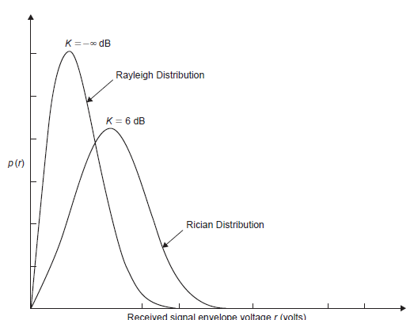
Statistical Distributions
Thus, the fading characteristics of a mobile radio signal are described by the following statistical distributions,
Rician Distribution
Rayleigh Distribution
Lognormal Distribution
[ Rayleigh Distribution &Rician Distribution ]

Slide 10
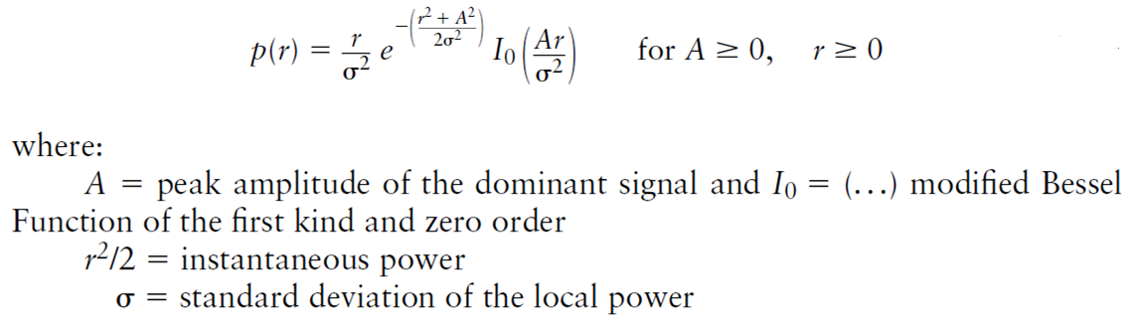
Rician Distribution
When there is a dominant stationary (nonfading) signal component present, such as a LOS propagation path, the small-scale fading envelope distribution is Rician.
The Rician distribution has a probability density function (PDF) given by:

Slide 11
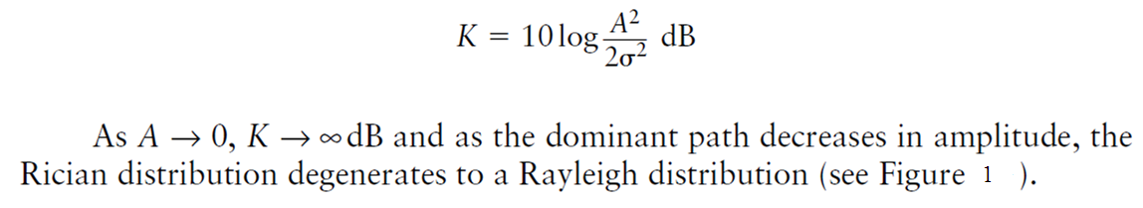
Contd.
The Rician distribution is often described in terms of a parameter K, known as the Rician factor and is expressed as:

Slide 12
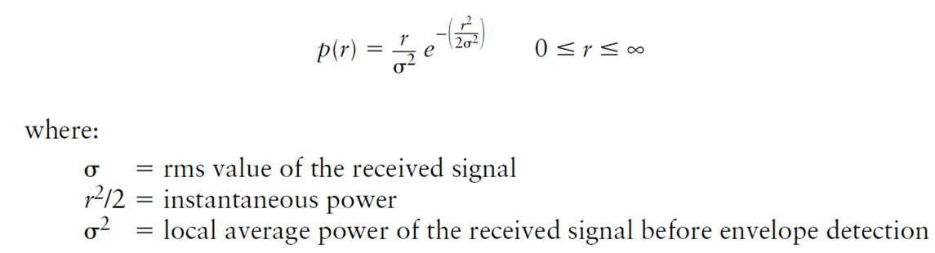
Rayleigh Distribution
The Rayleigh distribution is used to describe the statistical time-varying nature of the received envelope of a flat fading signal, or the envelope of an individual multipath component.
The Rayleigh distribution is given as:

Slide 13
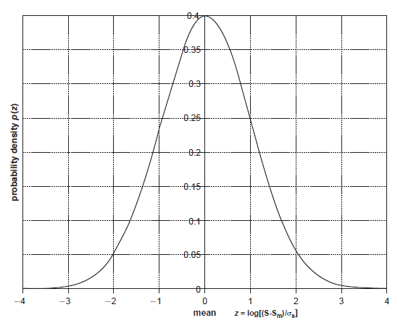
Lognormal Distribution
Lognormal distribution describes the random shadowing effects which occur over a large number of measurement locations which have the same transmitter and receiver separation, but have different levels of clutter on the propagation path.
The signal, s(t), typically follows the Rayleigh distribution but its mean square value or its local mean power is lognormal in dBm with variance equal to σ_{s}² .
Typically the standard deviation, σ_{s} equals 8 to 10 dB.

Slide 14
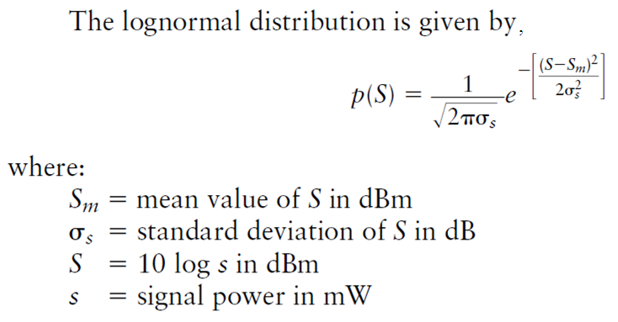
Contd.

Slide 15
The End

